Slide 1
ONLINE EDUCATION MODULE Name:- B.saidarao reg :- 192011034

Slide 2
AIM:- To Analyse Online Education Module

Slide 3
REQUIREMENTS:- 1.Login module 2.User Name 3.Password 4.website(payment module)

Slide 4

Online education login page

Slide 5
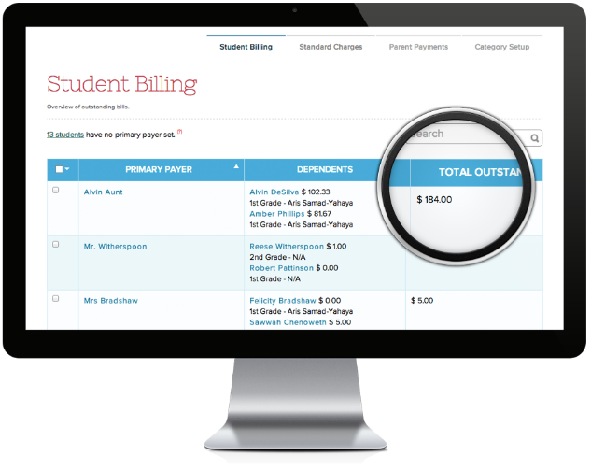
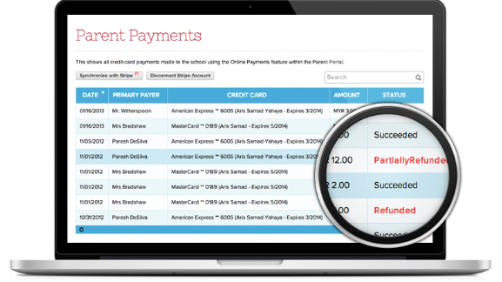
Searching page

Slide 6
Postive Test Scenario:- 1. Collect proper test data for the dummy credit card number for the maestro, visa, master etc. 2.Collect payment gateway information like Google Wallet, Paypal or else. 3.Collect payment gateway document with error codes 4.Understand the session and parameters passed through application and payment gateway 5.Understand and test the amount related information passed through query string or variable or session 6.Along with payment gateway language check the language of the application 7.Under the various settings of payment gateway like currency format, subscriber data collected

Slide 7
Negative Test Scenario Insert an incorrect email address in the email field. In a contact number box, try entering a fake phone number (characters). Add an image with a size that exceeds the given limit. In the picture upload section, upload incorrect files such as XML, SQL, and so on. What follows if the number of individuals (weight) surpasses the maximum allowed? What if someone smokes or starts a fire inside the elevator? What happens if the electricity goes off while the machine is running?

Slide 8
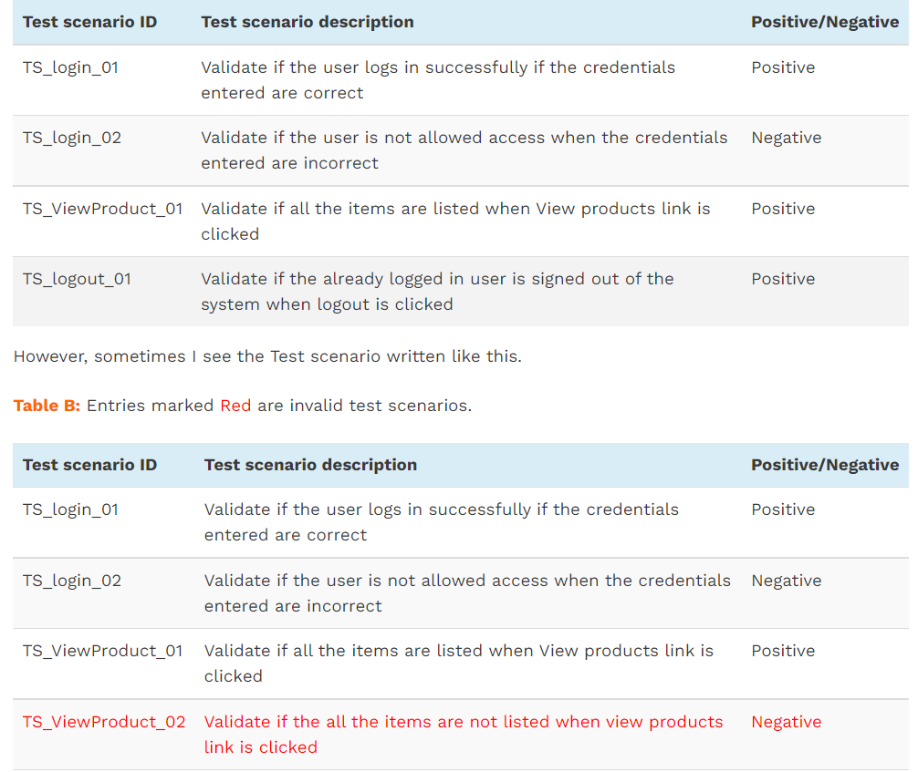
TEST CASES:-

Slide 9
CONCLUSION:- In culmination, a comparative study between classroom study and online study was carried out. The study was done by examining the findings recorded in books and journals on the applicability online learning to students. The study revealed that, online learning has many benefits as compared to the conventional learning in the classroom environment.

Slide 10


